Slide 1
CWC 2016 Tunnel Team B (Electrical): Final Concept
Michael Evans, Korey Holaas, Scott Muente,
Jess Robinson, Zachary Sabol, and Brayden Worrell

Slide 2
Project Description
Design, iterate, and build a small-scale turbine to perform in the CWC 2016 competition that reflects the business plan drafted by the Deployment and Business portions of the team.
  Sponsored by: The US Department of Energy (DoE) and the National Renewable Energy Laboratory (NREL).
  Advised by: David Willy, Karin Wadsack.
Slide number - names

Slide 3
Design Requirements
Engineering Requirements:
  Produce Continuous Power (1)
  Withstand High Wind Speeds (2)
  Design an Innovative Load (3)
  Fit the Design within the Testing Space (4)
  Quickly Assemble and Disassemble (5)
  Shut Down on Push Button Activation or Loss of Power (6)
Design Links:
  Controls: State Diagram and Braking (ER’s 2, 5, & 6)
  Load: Diversion Load (ER’s 1, 2, 3, & 5)
  Power Electronics: Rectification (ER 1, 2, & 4) and DC/DC Conversion (ER 1, 2, & 4)
  Software: State Diagram and Algorithms (ER 1, 2, & 6)
Slide number - Brayden Worrell

Slide 4
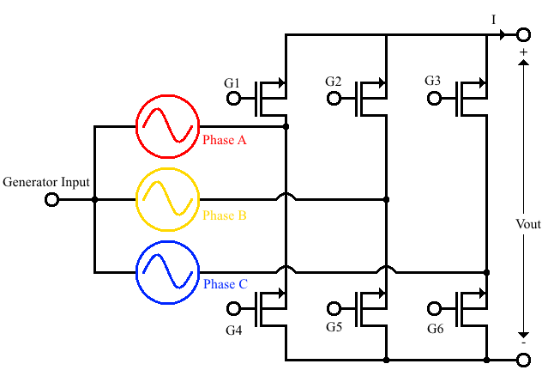
Design Description - Power Electronics
Active Rectification with MOSFETs
  Uses transistors to switch between different parts of a circuit, converting AC power to DC power.
  Causes a miniscule loss (under half a volt) while drawing little power.
  Chosen the STP 75nf75 MOSFET [B1].
Slide number - Brayden Worrell

Slide 5
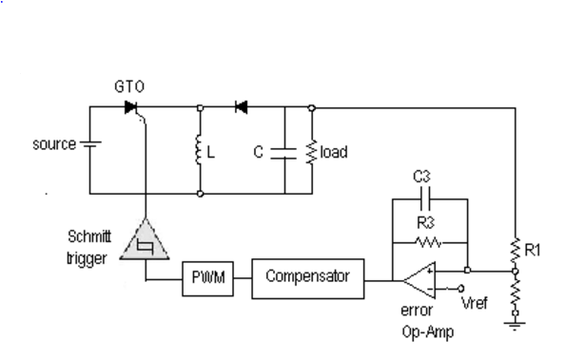
Design Description - Power Electronics
Buck-boost Converter
  Utilizes MOSFETs as switches to control flow of current through the power stage.
  Duty cycle regulated by closed-loop voltage-mode controller.
  Synchronous vs. Asynchronous
  Continuous Conduction Mode (CCM)
  Power Quality
Slide number - Korey Holaas

Slide 6
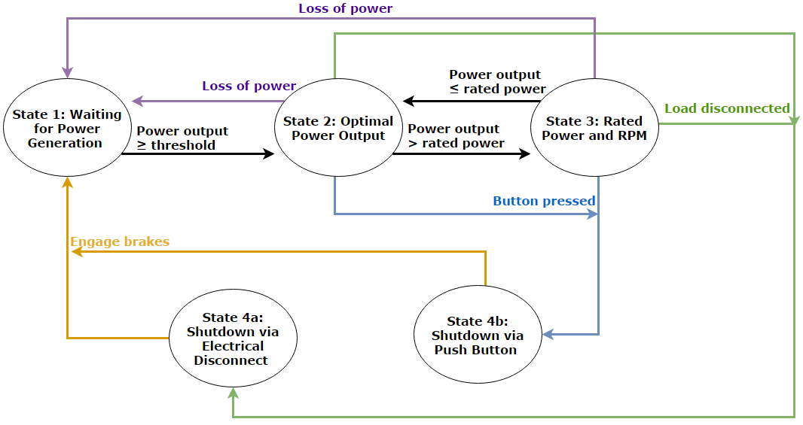
Design Description - Controls and Software
State diagram
  Threshold
  Rated power
  Pushbutton
  Load disconnected
  Brakes
Slide number - Michael Evans

Slide 7
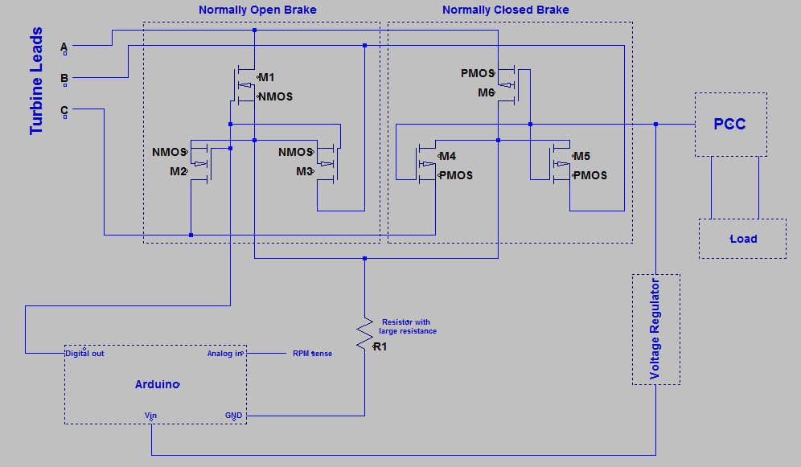
Design Description - Controls and Software
Brake System
  Dual electrical brake: Split-up braking conditions with NMOS and PMOS transistors
  Inspired by 2014 Penn State design [J1]
  Still could add more redundancy to design → increase reliability
Slide number - Jess Robinson

Slide 8
Design Description - Load
Diversion Load
  A diversion load allows us to charge a battery bank without having to worry about over charging it
  When the battery is fully charged the controller (Arduino micro controller) uses a control switch to switch power to the resistive, diversion load.
  The battery will be a 12V, .8Ah lead acid battery
Display Chosen
  An arduino with a bluetooth to send information from the turbine to a computer
  Bean use 3.3 to 5 V
  Bean to iPhone 250 meters or 820 feet
  Bean to Bean 400 meters or 1300 feet
Slide number - Scott Muente, Zachary Sabol

Slide 9
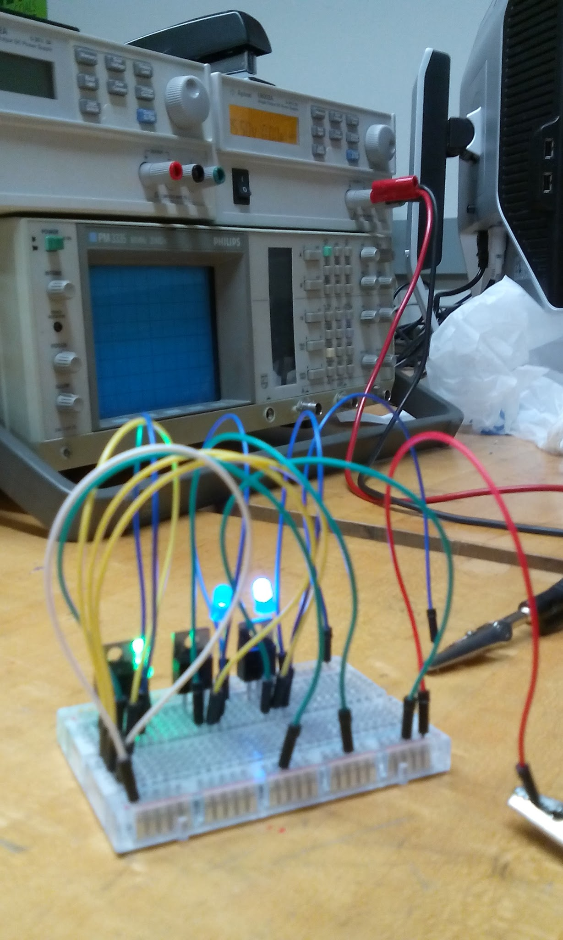
Prototype
During the presentation, smoothly transition to showcasing the prototype you have built and how it impacted your design.
  Proof-of-Concept Prototype:
    Arduino Uno (control system)
    MOSFETs and LEDs
    Power Supply (turbine)
  A slightly larger but to scale prototype of the load.
    Gives us an idea of the dimensions of the load
    The load will be hooked up but not mounted or attached to the turbine
    Feel free to move around my picture of the proof-of-concept to fit a picture of the load prototype, if you have one. - Jess
Slide number - Scott Muente, Jess Robinson, Zachary Sabol, Brayden Worrell

Slide 10
Budget
Describe the project’s budget including total dollars available, anticipated expenses, actual expenses to date, and the resulting balance. What is the DOE budget again?
  Future expected costs, previous costs, and estimated dates for those costs (buy on/by this date).
Electrical brakes:
  PMOS and NMOS transistors (activate brakes)
  Wires, connectors, and electrical tape
  Total: $81.60 [J2], [J3]
Load:
  P75NF75 MOSFETs
  Total: $9.10
Budget statuses for other turbine components?
Slide number - name

Slide 11
Schedule
Provide a schedule for the next term showing when key tasks will be completed. Indicate if you are currently on, ahead, or behind schedule.
  Include major and minor deliverables, but leave out weekly meetings (times still unsure).
Slide number - Zachary Sabol

Slide 12
Schedule part 2
continued
Slide number - Zachary Sabol

Slide 13
Work Cited
[B1] - STMicroelectronics. (2007). N-channel 75V - 0.0095Ω - 80A - TO-220 - TO-220FP - D2PAK STripFET™ II Power MOSFET [PDF]. Available FTP: http://www.st.com Directory: web/en/resource/technical/document/datasheet/CD00002771.pdf
[J1] - K. Palamara, et al., “A review of the conceptual design process and the analysis of the remote wind PSU turbine,” Penn State Univ., State College, PA, 2014.
[J2] - J. Robinson, “Amazon Purchase Order,” PO-CWC16-Tb-Amazon-002, Nov. 20, 2015.
[J3] - J. Robinson, “DigiKey Purchase Order,” PO-CWC16-Tb_DigiKey-001, Nov. 20, 2015.
[2]
[3]
[4]
[5]
...
Slide number

Slide 14
Questions?

